Slide 1


Welcome to ASEN 3728 Aircraft Dynamics!
ASEN 3728 Aircraft Dynamics
UNIVERSITY OF COLORADO BOULDER

Slide 2
Outline
What is A/C Dynamics About?
Course Logistics
Nomenclature
My Background

Slide 3
Aircraft Dynamics and Controls
Aeronautical Engineering
Aerodynamics
Structures and Materials
Propulsion
Dynamics and Controls
Keep the pointy end in front
Get the aircraft to where we want to go
In this class, we will
Develop a mathematical model of aircraft (A/C) behavior
Learn how to create an aircraft computer simulation model
Design control systems to effect desirable dynamics

Slide 4
Aircraft Dynamics
Newton’s Laws (ASEN 2703)
Inertial
Reference Frame
+ Aerodynamics (ASEN 2702,
ASEN 3711)
Body
Reference Frame
Aircraft Dynamics (ASEN 3728)
Nonlinear Equations of Motion

Slide 5
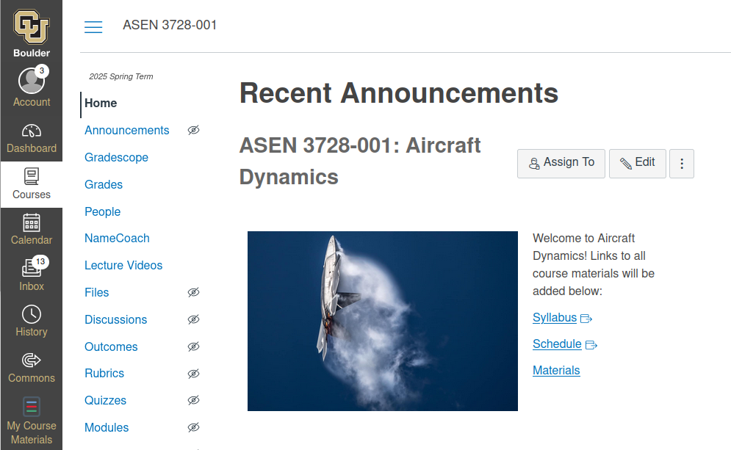
Course Hub: Canvas

Slide 6

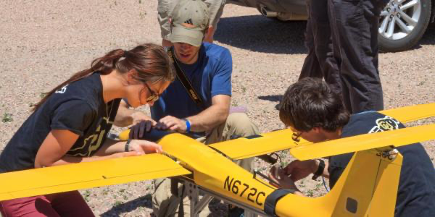
My Assumptions
The material is challenging, and can take multiple engagements to understand fully
A student who comes to my office or asks a question wants to learn
It may take multiple ways of explaining a concept before a student understands
We must work together to help you find the way to understand
Taking notes in class and doing the homework yourselves are critical steps to understanding
I am trying to bring you to the point of understanding, not just give you the answer
We will have fun this semester

Slide 7


Slide 8


3728.O
3728.O
Once a week I will feature course-related memes and videos from the Internet.
Students should email me links to memes and videos on topics related to the course content (not about the course itself).

Slide 9


3728.O

Slide 10
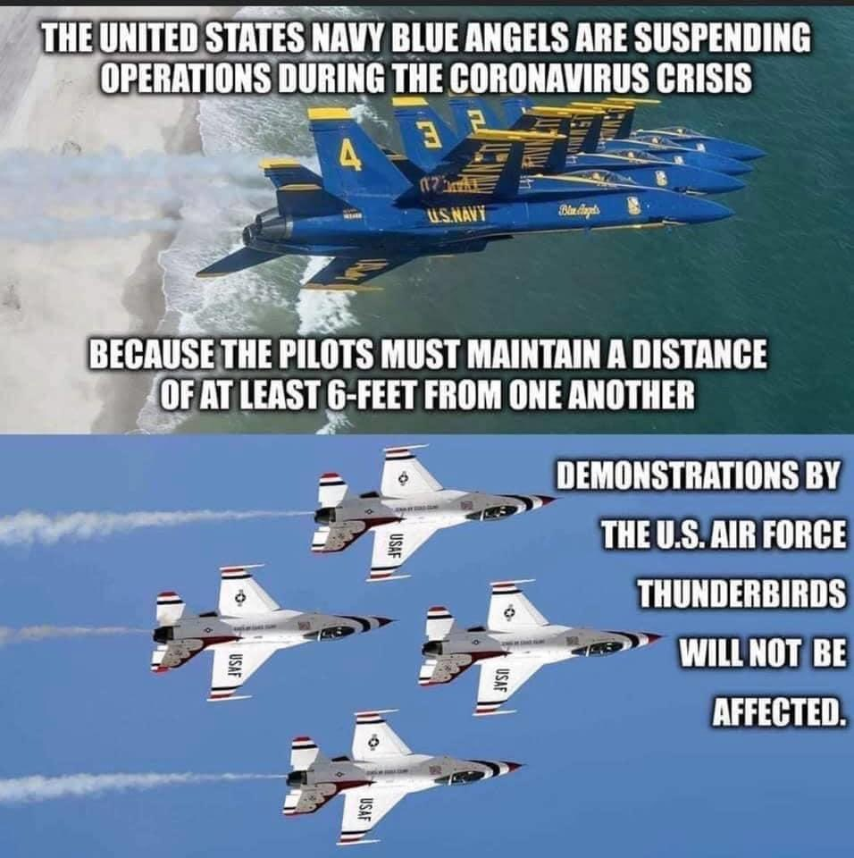
3728.O

Slide 11
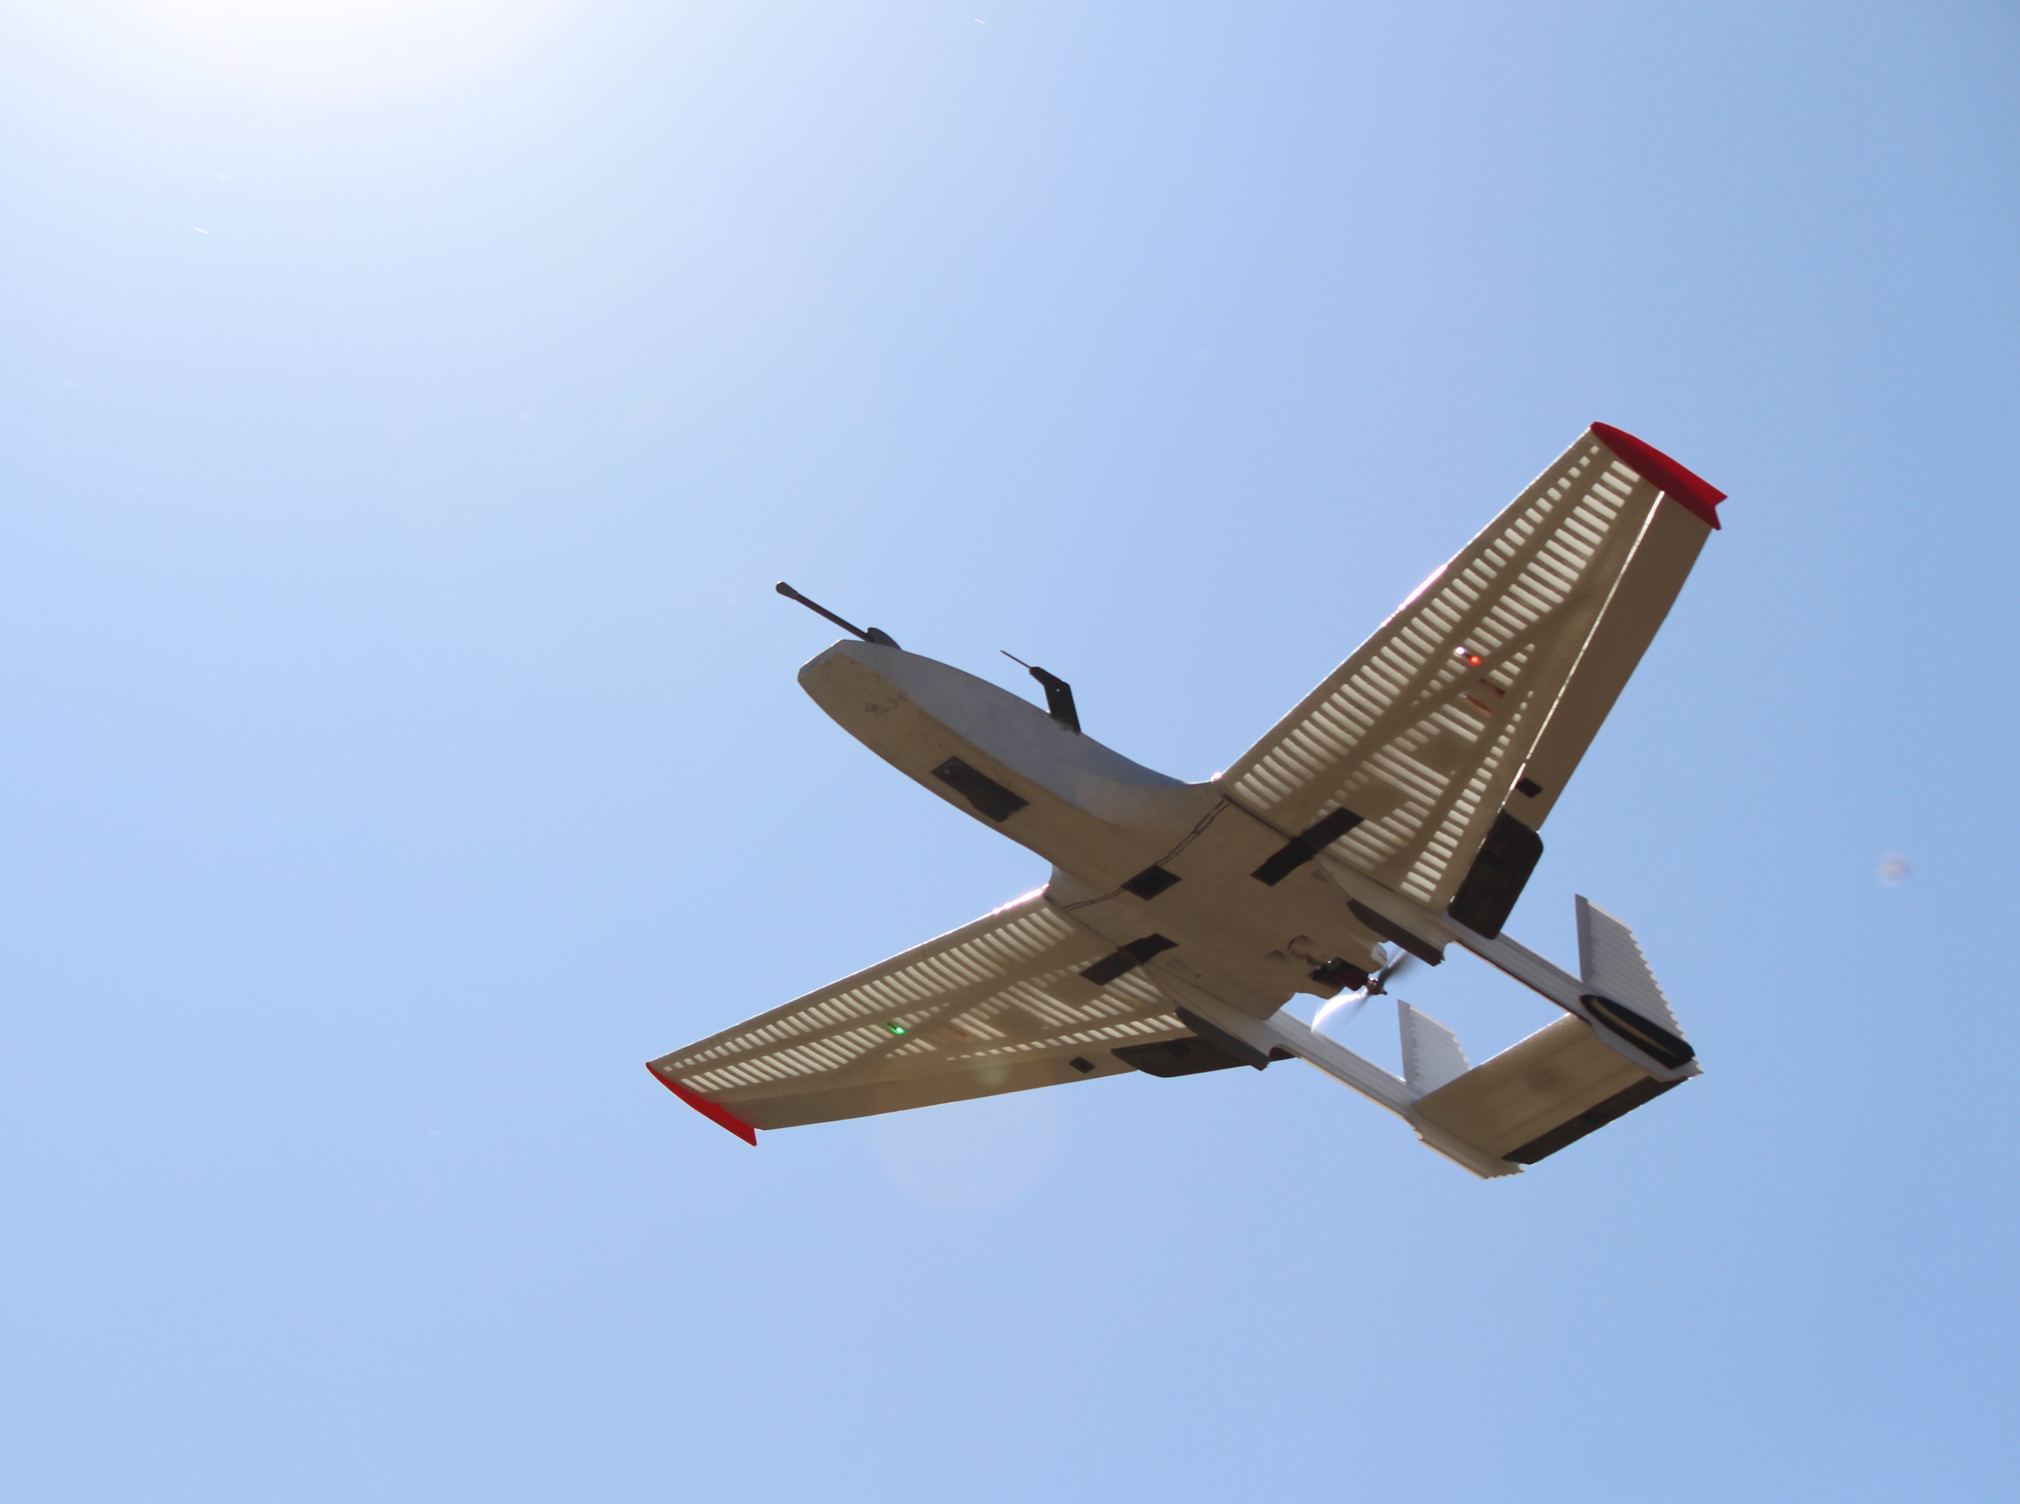
Break

Slide 12
True or False Question
Expect TRUE/FALSE questions as part of the Homework and Exams. In all cases students are expected to provide a concise, correct, logically sound justification for full credit.

Slide 13
True or False Question
True or False: Given this velocity vector one can conclude that the aircraft is ascending? Justify your answer.

Slide 14
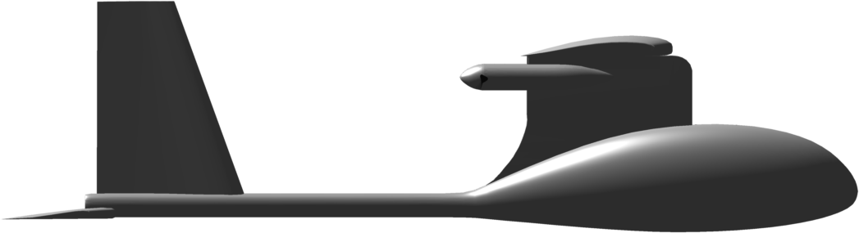
True or False Question
True or False: Given this velocity vector one can conclude that the aircraft is ascending? Justify your answer.
The vector is the inertial velocity expressed in body coordinates. In order to know if the aircraft is ascending you need to know the vector in inertial coordinates. In order to calculate this vector, we need to know the orientation of the aircraft.
False
Both figures satisfy the given conditions!

